Slide 1
Fudamentals of Virtual Reality
Jesse Lane - Vault Labs

Slide 2
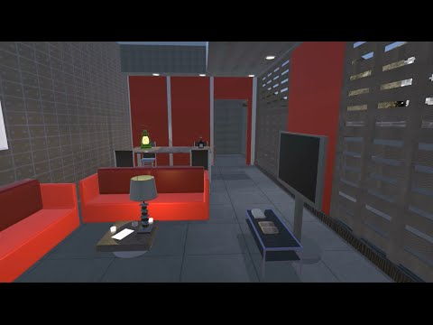
Some Definitions
Virtual Reality
Using different technologies like, computer graphics and sound, to create an immersive “fake” world.
Immersion: Feeling like you are actually there.

Slide 3
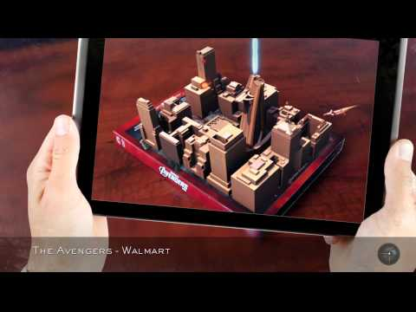
Some Definitions
Augmented Reality
Overlaying virtual information onto the real world.

Slide 4
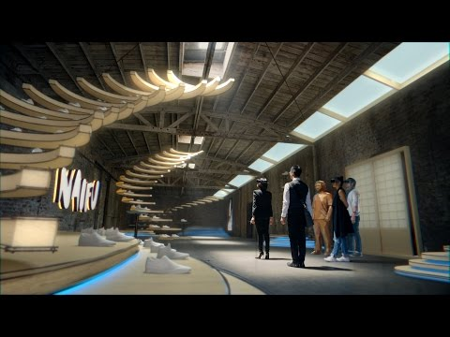
Some Definitions
Mixed Reality
Combining the virtual and real worlds so that real and virtual objects can interact.

Slide 5
Some Definitions
Stereoscopic
Presenting an image separately to each eye for depth.
Audio
Sound, usually in 3D for virtual reality.
Haptics
Using the sense of touch. Your phone vibrating when a button is pressed is a simple version.
Olfactory
Smell. Yes, there are really people working on this.
Taste
This one too. Some people have attached electrodes to the tongue to stimulate taste.
Vestibular
Sense of balance. When this conflicts with what you see, you fall down.

Slide 6
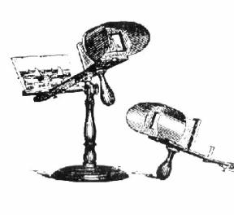

A Bit of History
Attempts at virtual reality are older than you think!
Stereoscopes (early 1800s)
Although, a few were made using paintings in the 1600s.
And, of course, the View Master!

Slide 7
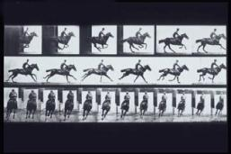
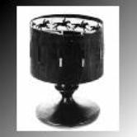
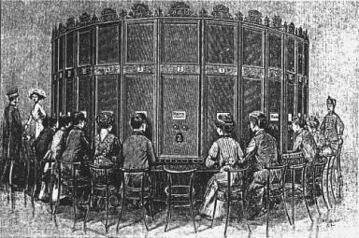
A Bit of History
Kinematoscopes (by the 1860s)

Slide 8
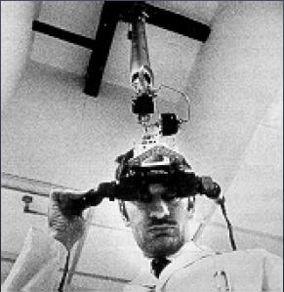
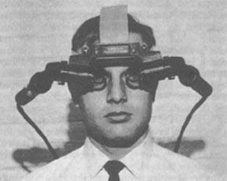
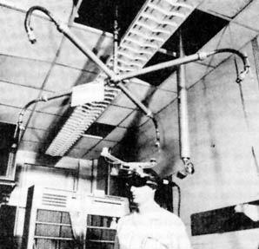
A Bit of History
Then things start getting weird in the late 1960s.

Slide 9
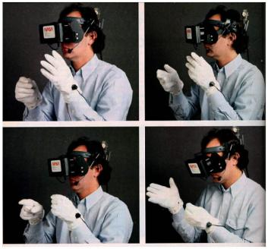
A Bit of History
In the 80s things start to look familiar

Slide 10
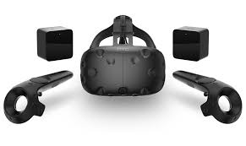
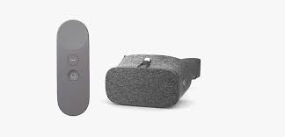
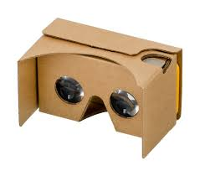
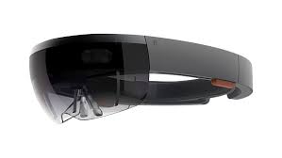
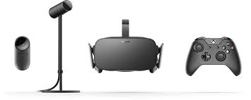
Today

Slide 11
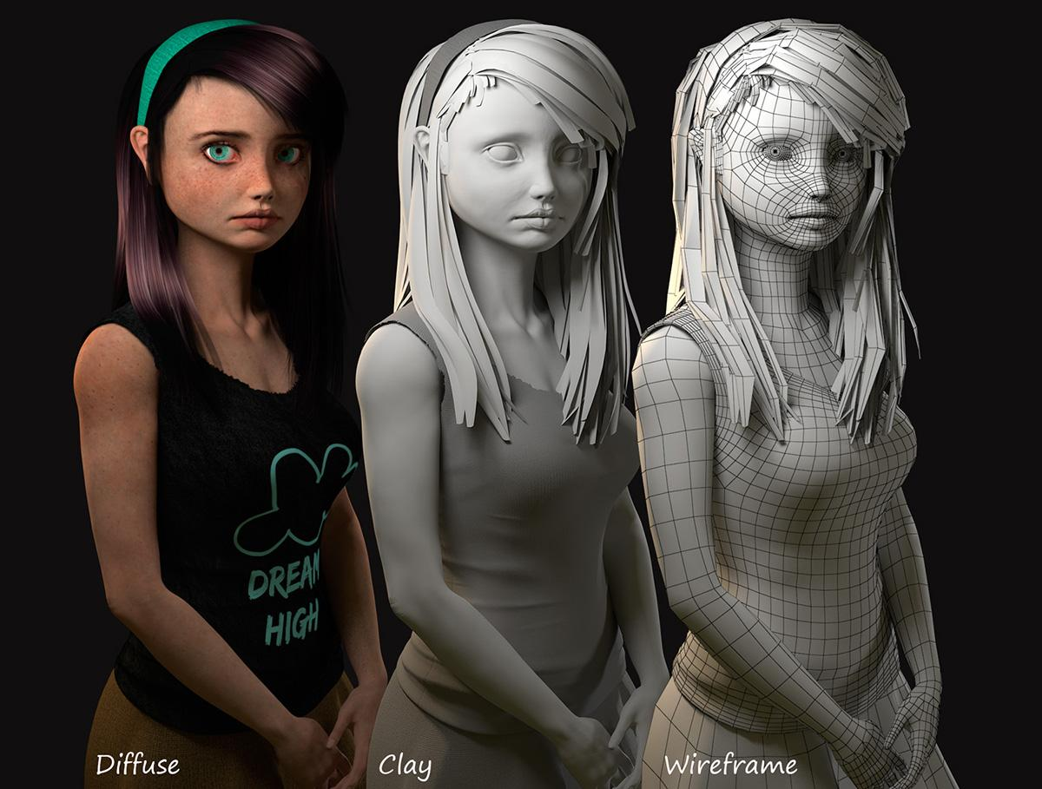
3D Modeling
Geometry
Lighting
Materials

Slide 12
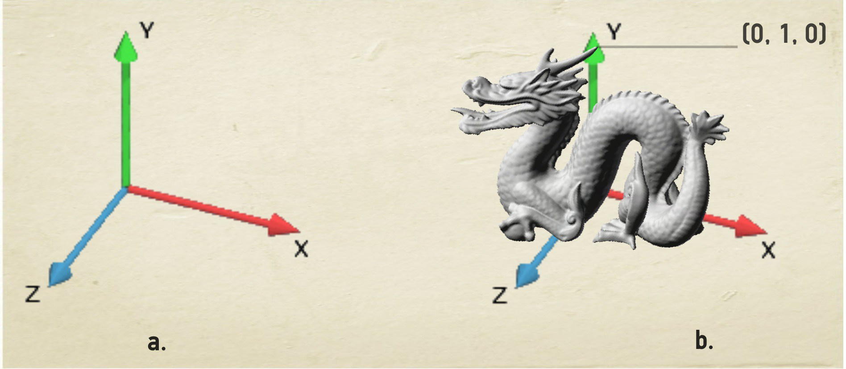
Coordinate Systems
Global Local

Slide 13
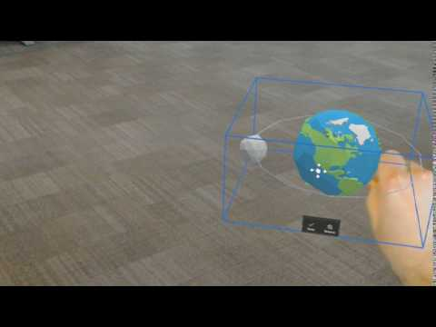
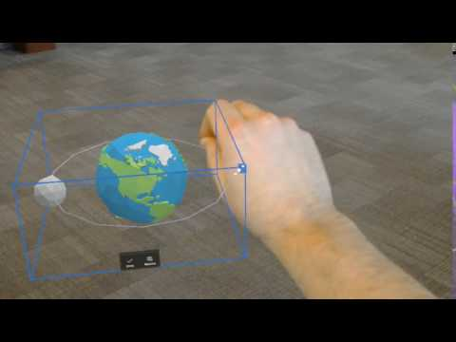
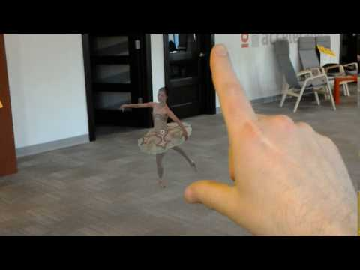
Transforms
Translation Scale Rotation

Slide 14
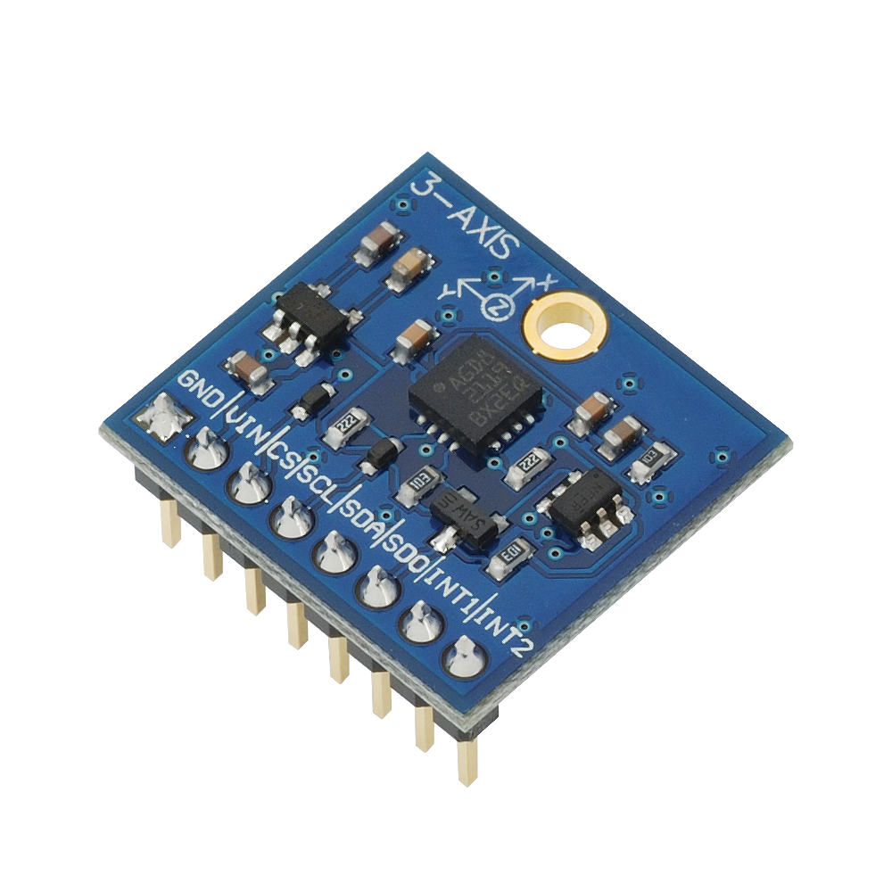
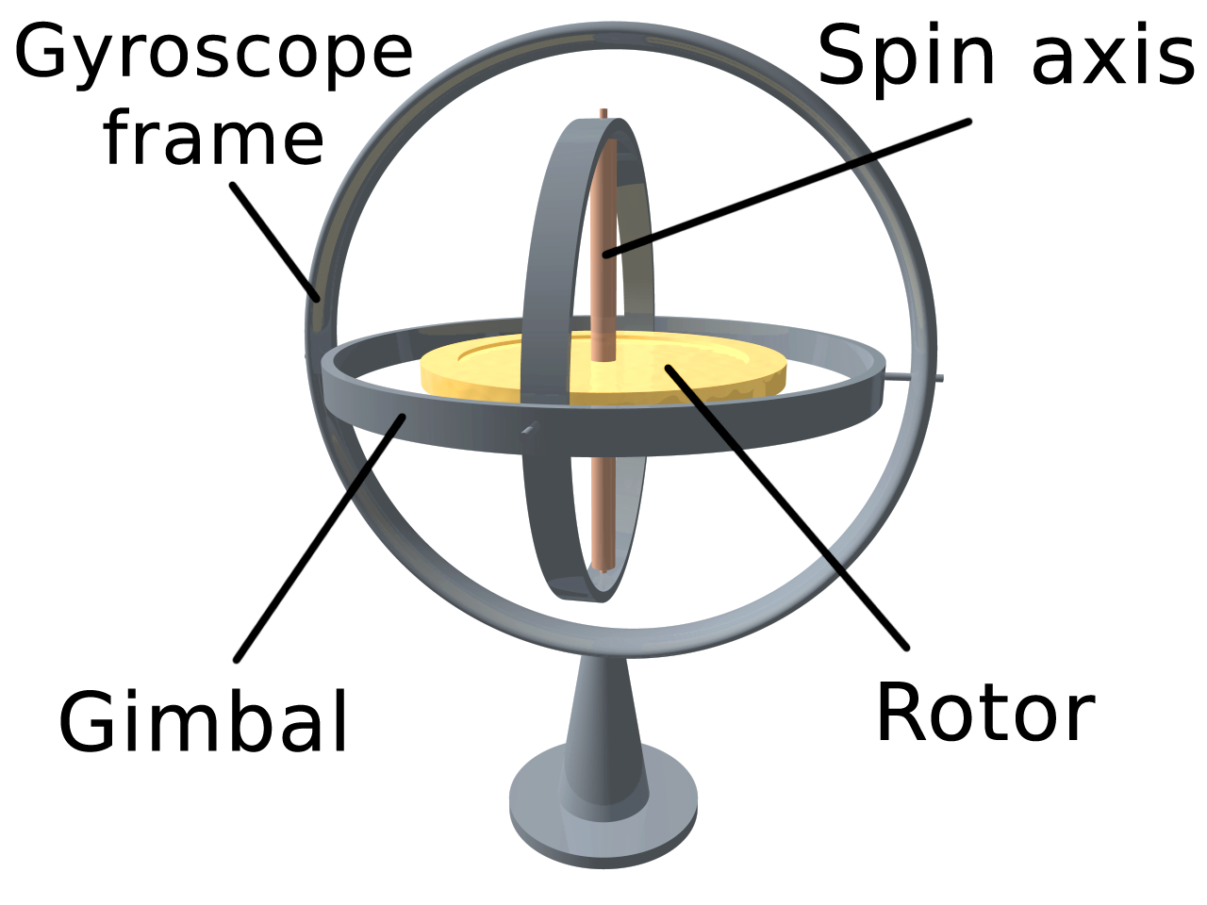
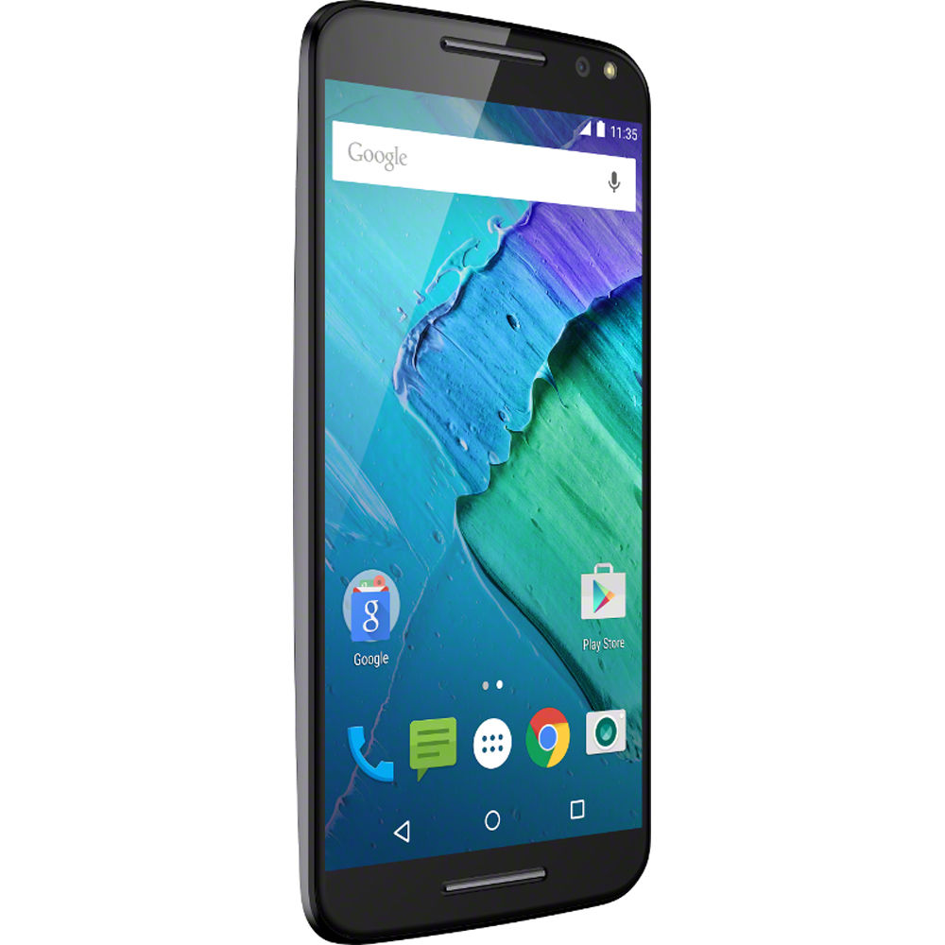
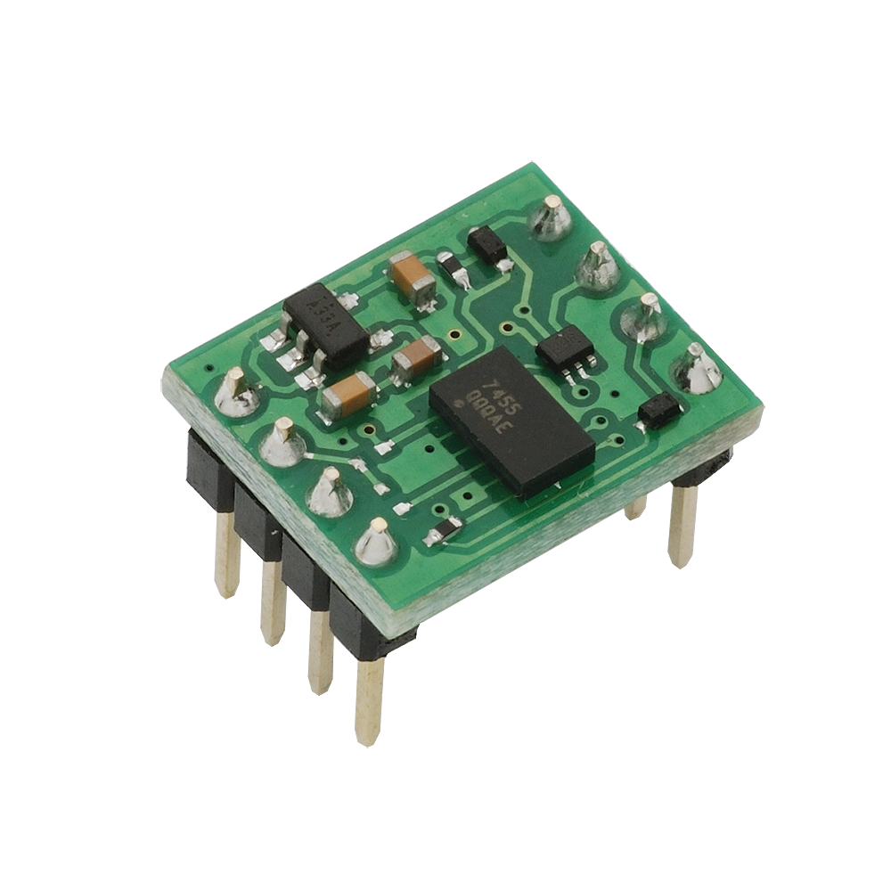
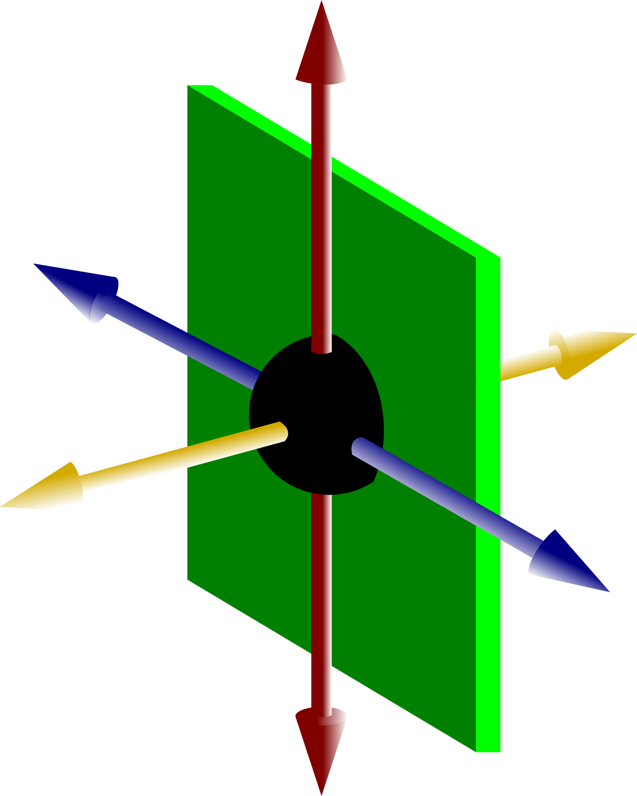
Tracking
Intertial tracking

Slide 15
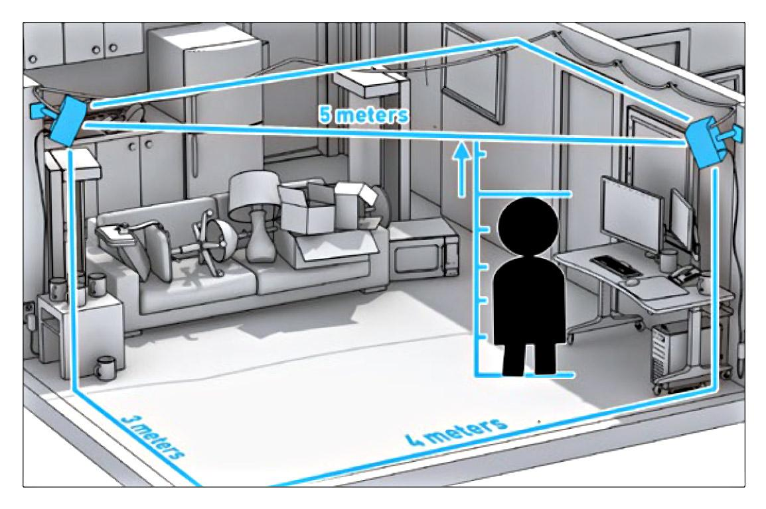
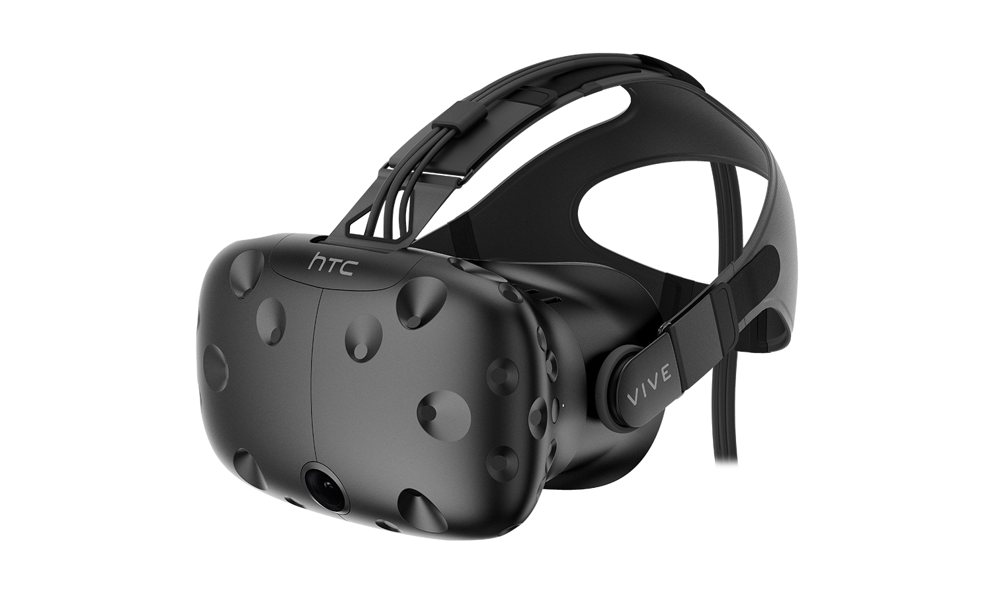
Tracking
External tracking

Slide 16
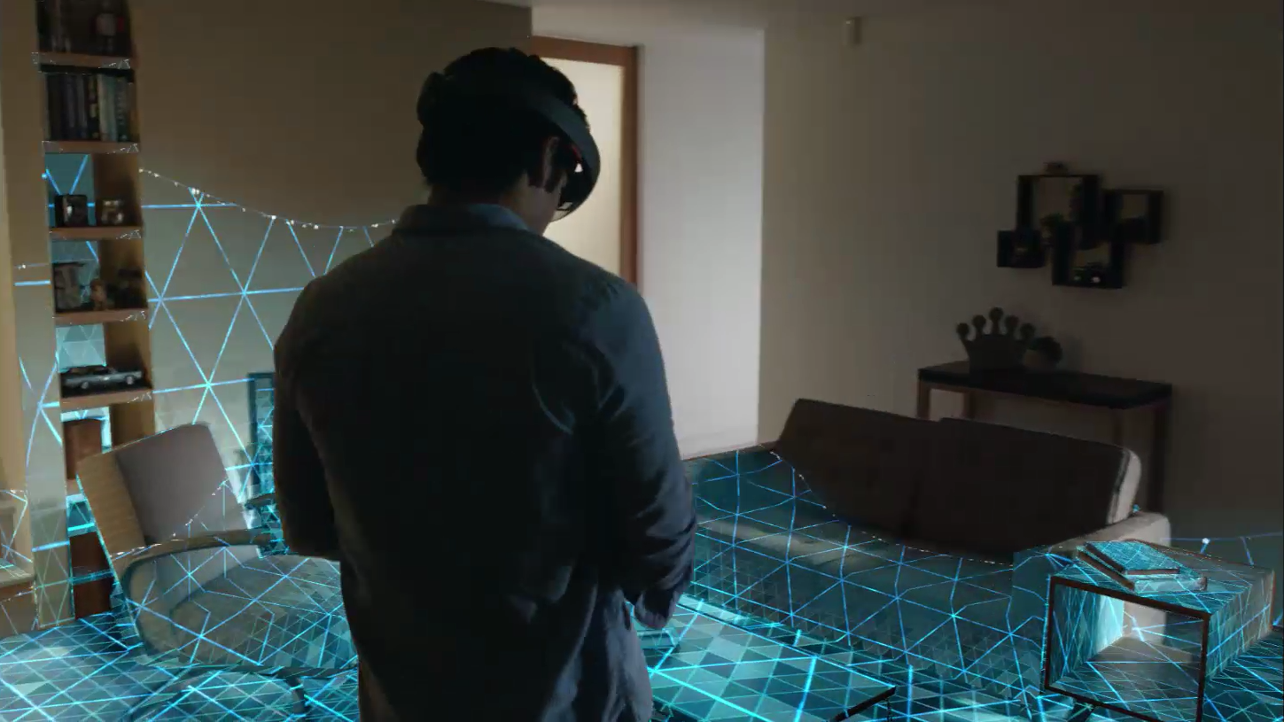
Tracking
Spatial mapping

Slide 17

Next time...
Basic Virtual Reality Development

Slide 18
Questions?

